Slide 1

CUCUMBER BDD
Copyright © 2018 by Khanh Tran at testmaster.vn

Slide 2
Agenda
Definitions
Behavior Driven Development
Cucumber Structure
Gerkin
Demo

Slide 3
What is Behaviour-Driven Development
Outside-in software
Helps document what the system should do
Validates that the right system is being built
Product owner point of view
Written in non-technical format
Pass/fail
When automated, become « living documentation »
Usually execute a vertical slice through the system (!= unit test)
Shared team understanding of what’sbeing built
Helps define what « done » means
Notes:
The system implement the right features required by user, busines, customer.
Product owner point of view but everybody should write them
Easy to understand format mais facielement traduisible into automatable steps
UT = technical living doc
AT = business living doc
http://referentiel.institut-agile.fr/bdd.html

Slide 4
Test-First Approaches
Collaboratively define what the system should do next
Write the tests in Cucumber
Write Code
no
yes
All tests pass?
Notes:
The system implement the right features required by user, busines, customer.
Product owner point of view but everybody should write them
Easy to understand format mais facielement traduisible into automatable steps
UT = technical living doc
AT = business living doc
http://referentiel.institut-agile.fr/bdd.html

Slide 5
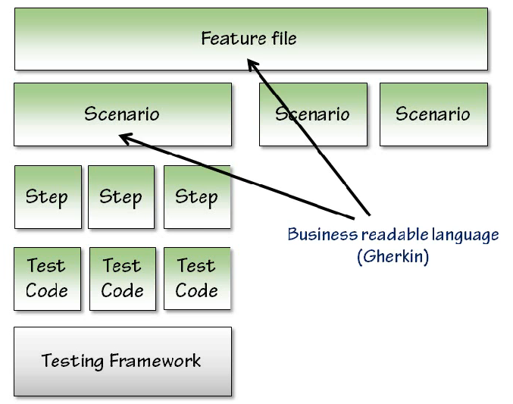
Cucumber Structure
Notes:
The system implement the right features required by user, busines, customer.
Product owner point of view but everybody should write them
Easy to understand format mais facielement traduisible into automatable steps
UT = technical living doc
AT = business living doc
http://referentiel.institut-agile.fr/bdd.html

Slide 6
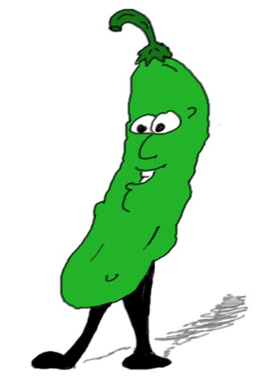
What is Gherkin
Business readable domain specific language
Represents tests in natural language, not code
Line-oriented
Uses indentation to create structure
Keywords
+40 spoken languages

Slide 7

Features
Top level grouping
Contain one or more scenarios
Contain logically related test scenarios
Represent small, discrete features of the system

Slide 8
Scenarios
Concrete examples of expected system behaviour
Each scenario describes a particular situation
Each scenario should be independent and isolated
Can represent: happy paths, error paths, edge cases

Slide 9

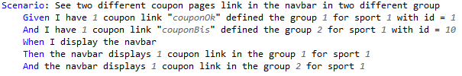
Scenario steps keywords
Set up initial state : Given
Perform action(s) : When
Check end state : Then
Notes:
And : plus facile à lire

Slide 10
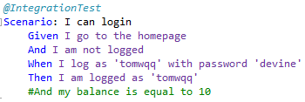
Tags
Mark features and scenarios with arbitrary tags
Map to unit test framework « categories »
Scenarios « inherit » features tags
Can have multiples tags
Tags specified using @
@ignore is a special case

Slide 11
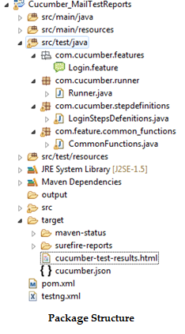
Cucumber Project Structure
A Feature File is an entry point to the Cucumber tests.
This is a file where we will describe our tests in Descriptive
Language (like English)
Cucumber uses Junit Runner. This class will use the Junit
Annotation @RunWith(). It more like a starting point for Junit
to start execting our Tests.
Step Definition is a class with an annotation. Cucumber finds
the Step Definition file with the help of Glue code in Cucumber
Options.

Slide 12
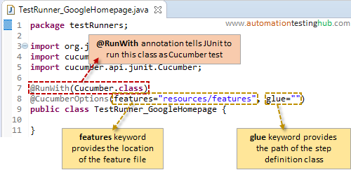
Cucumber Options
Options Type | Purpose | Default Value
dryRun | True: Checks if all the Steps have the Step Definition | False
features | Set: The paths of the features files | { }
glue | Set: The paths of the step definition fiels | { }
tags | Instruct: What tags in the features files should be exectued | { }
monochrome | True: Display the console Output in much readable way | False
format | Set: What all report formatters to use | False
strict | True: Will fail execution if there are undefined or pending steps | False

Slide 13
Hooks
Hook are blocks of code that can run at varous points in the Cucumber execution cycle. They are typically used for setup and teardown of the environment before and after each scenario.
Scenario hooks: run for every scenario
Before: hooks run before the first step of each scenario. You can specify an explicit order for hooks if you need to. Eg: @Before(order=10)
After: hooks run after the last step of each scenario, even when steps are failed, underfined, pending or skipped
@After
public void doSomethingAfter(Scenario scenario){
if (scenario.isFailed()) {
byte[] screenshot = webDriver.getScreenshotAs(OutputType.BYTES);
scenario.embed(screenshot, "image/png");
}
}

Slide 14
Hooks
Step hooks: Step hooks invoked before and after a step. The hooks have ‘invoke around’ semantics. Meaning that if a BeforeStep hook is executed the AfterStep hooks will also be executed regardless of the result of the step. If a step did not pass, the following step and its hooks will be skipped.
BeforeStep
AfterStep
Tagged hooks can be conditionally selected for execution based on the tags of the scenario. To run a particular hook only for certain scenario, you can associate a Before or After hook with a tag expression
@After("@browser and not @headless")
public void doSomethingAfter(){
}

